Slide 1
R Training 2024
Introduction, interface and packages
06AUG2024

Slide 2
01
02
03
04
05
06
Introduction to training
How to access training
R interface
Packages
Examples: Accessing Posit workbench and trainings
Questions

Slide 3
Introduction
4 weeks of R basics
6 weeks of R for SDTM/ADaM
5 weeks of R for TLFs
All training is available through Sharepoint
Each topic will include a self-paced training and a set of exercises

Slide 4
Schedule
Week 1:
    Introduction meeting
    Assigning Values, Vectors, Logical tests and Boolean Operators
Week 2:
    Q&A meeting
    Chaining Functions
    Strings and Arguments
Week 3:
    Q&A meeting
    Mutate, Summarise and Group_by
Week 4:
    Q&A meeting
    Types of Data, Filter Rows and NAs
    Chaining Functions with Datasets
Week 5:
    Q&A meeting
    SDTM/ADaM training to begin

Slide 5
Example:
Accessing trainings

Slide 6
R Interface

Slide 7
Posit Workbench
Instructions on how to access Posit Workbench can be found at this link:
user_guide - Default

Slide 8
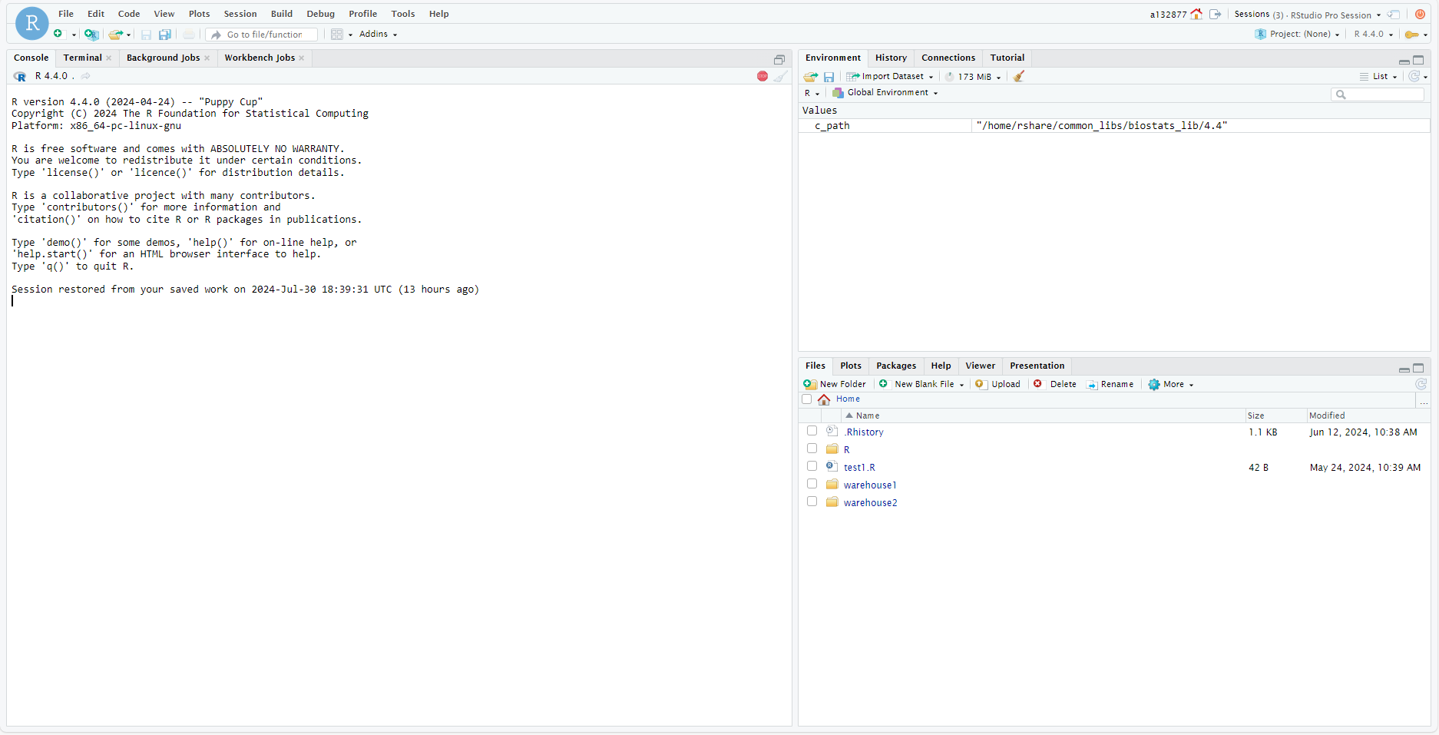

Slide 9
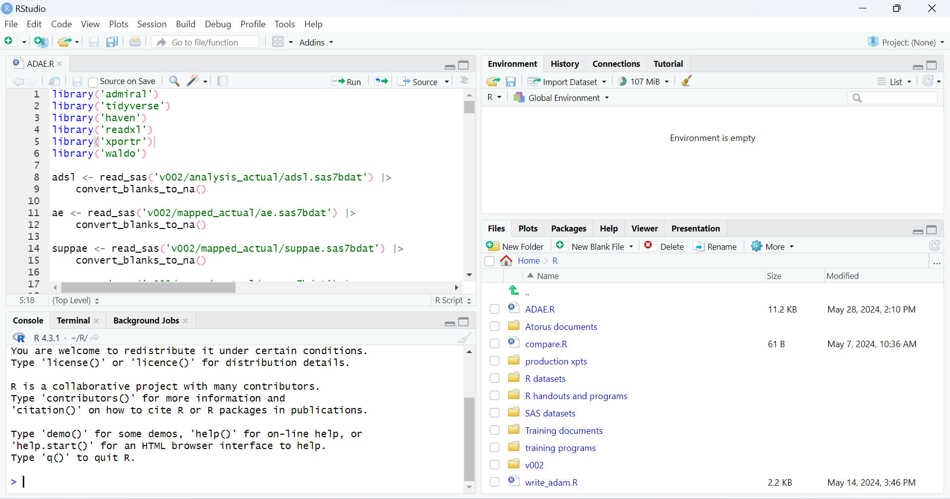
1
2
4
3

Slide 10
1

Slide 11
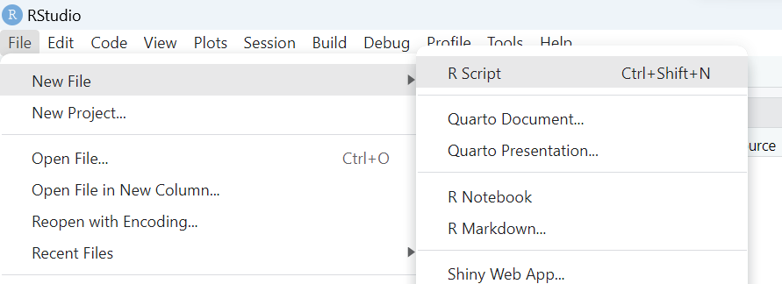
Opening a new R file

Slide 12
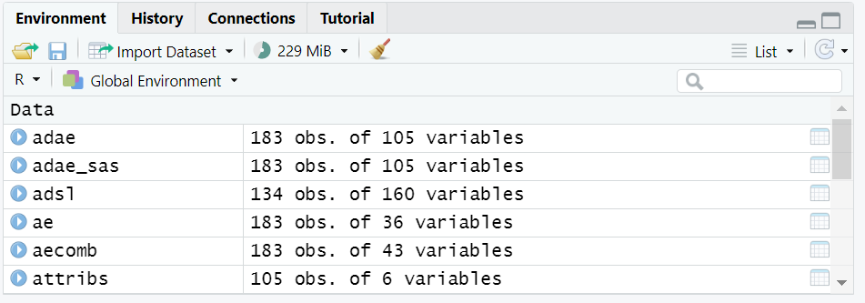
2

Slide 13
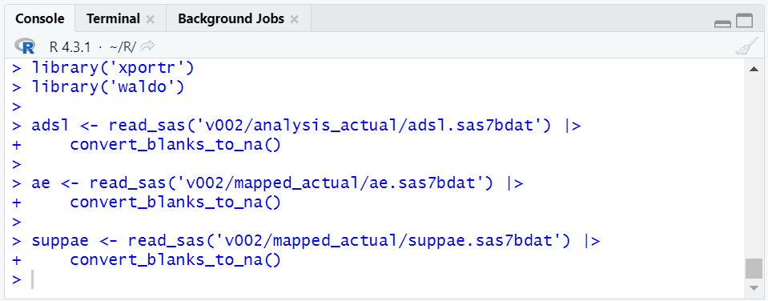
3

Slide 14
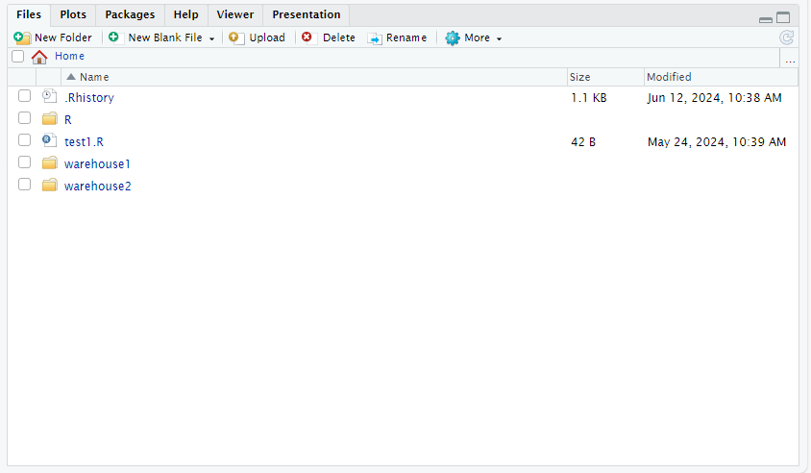
4

Slide 15
Example:
Accessing Posit workbench

Slide 16
Packages

Slide 17
Packages
Open-source packages
Each package contains functions
E.g. package haven includes function read_sas()
Follow ‘SH: 3924.00 (SOP), R Package Request, Installation, Validation and Release’ to get new packages approved

Slide 18
Installing and Loading
Each package needs to be installed once
install.packages(“haven”)
Each package needs to be loaded at the beginning of every program
library(haven)
haven::read_sas()

Slide 19
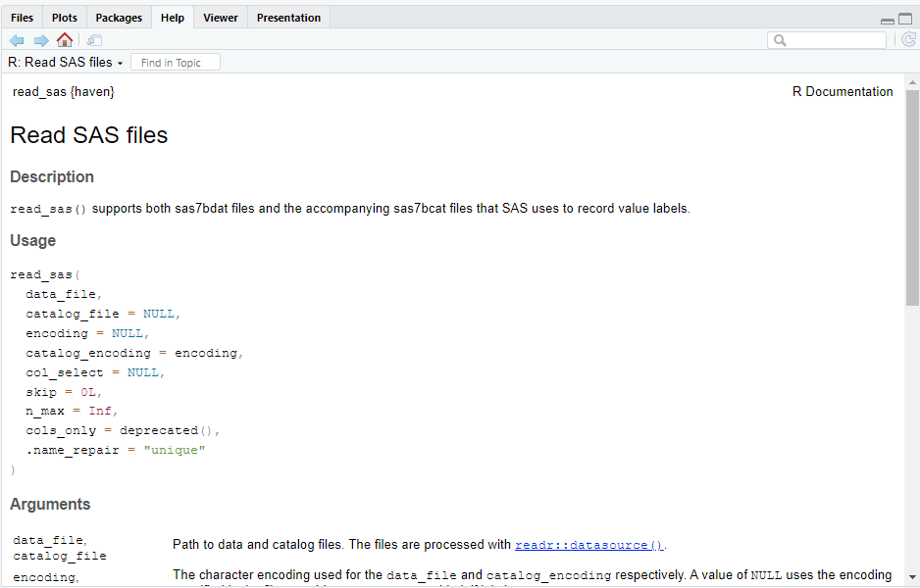
Help pages
?read_sas
4

Slide 20
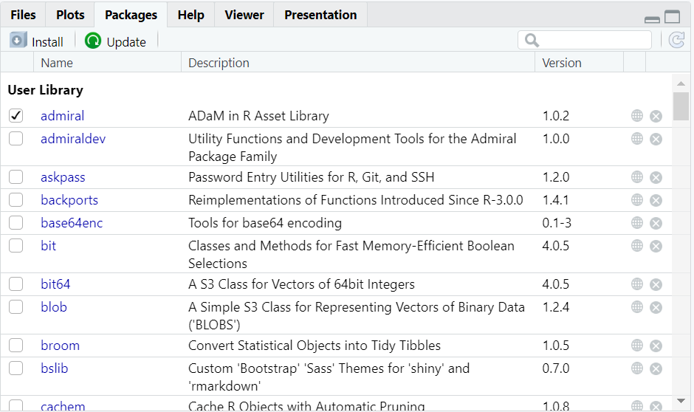
4

Slide 21
Any Questions?

